Slide 1

Lecture 3
Callback, HTTP and REST

Slide 2

Agenda
What is HTTP?
What is API?
HTTP methods & Rest
HTTP requests
HTTP responses
HTTP status codes
What makes a good API?
What is callback function?

Slide 3



What is HTTP?
HTTP is an application layer protocol which is used to serve content over the internet between a server and client
HTTP (HyperText Transfer Protocol) is a communication protocol which is built on top of TCP.
HTTP is stateless by design.
A complete data transmission consists of a request and a response, the client sends a request and gets back a response with the corresponding data.
User
Browser
Web Server
1. URL
Translating URL into HTTP request
2. HTTP request
Interpreting the request, retrieving required data files
Entry
http://www.example.com/index.html
GET/index.html
4. Webpage
Rendering data to final webpage
3. HTTP response
Sending status of search and data of the webpage
Screen
Display webpage index.html
Status code + webpage data

Slide 4
What is API?
An API (Application Programming Interface) is a set of rules and protocols that allows different software applications to communicate with each other. It defines the methods and data formats that applications can use to request and exchange information. Let’s use the customer, chef (server) and waiter as an example:
Customer: Represent the user or client who initiates a request for a specific dish (service) from the chef (server). The customer interacts with the waiter to place an order and receives the dish when it's ready.
Chef: Represent the server or provider of the requested service (dish). The chef processes the order received from the waiter and prepares the dish accordingly. Once ready, the chef hands it over to the waiter for delivery to the customer.
Waiter: Acts as an intermediary or interface between a customer and a chef. The waiter takes the customer's order (request) and communicates it to the chef, then delivers the prepared dish (response) back to the customer.

Slide 5
What is API?
What are the customer, chef and waiter actually stand for in this analogy?
Chef = API Provider/server: The entity that offers a set of services or functionalities that can be accessed by the users or client applications.
Customer = API Consumer/client: The application or system that sends requests to the API provider for specific services or data.
Waiter = API: The API serves as the intermediary that receives requests from the clients, processes them, interacts with the providers to fetch data or perform actions, and then sends back the response to the consumer.

Slide 6
HTTP Methods and Rest
REST stands for Representational State Transfer and it’s a guideline for writing and architecting cohesive and comprehensive APIs
Any API which conforms to the REST spec is said to be RESTful
GET | POST | PUT | PATCH | DELETE
Read Operation | Create Operation | Update (Replace) | Update (Modify) | Delete
Retrieve information from the API about a specific piece of data | Create a new entry in the backend | Replace an existing entry in the backend with another | Update certain properties of an existing entry in the backend | Delete a specific entry from the backend

Slide 7
HTTP Requests
A client makes an HTTP request to retrieve a certain type of information or make a certain transaction on the backend.
An HTTP Request can be broken down into three main parts, the request line, headers and the request body.
Method
Request-URI
Protocol version
Request line
PUT
/hr/ergonomics/posture.doc
HTTP/1.1
Host: www.example.com:8080
Content-Length: 1234
Headers
Empty line
Body (optional)
Body must include the number of characters specified in the content length header…

Slide 8
HTTP Responses
The second part of a full HTTP data transmission is the Response, a response is when the server has analyzed the request sent to it and sends back some data conforming to the data which was requested.
A HTTP Response can be broken down into three parts, Status Line, Response Headers and Response Body.
HTTP/1.1 200 OK
Date: Sun, 08 Feb xxxx 01:11:12 GMT
Server: Apache/1.3.29 (Win32)
Last-Modified: Sat, 07 Feb xxxx
Etag: “0 – 23 – 4024c3a5”
Accept-Ranges: bytes
Content-Length: 35
Connection: Close
Content-Type: text/html
<h1> My Home page </h1>
Status Line
Response message header
Response Headers
A blank line separates header & body
Response Message body

Slide 9
HTTP status codes
A status code is meant to give a numeric identifier to how the transaction went and is meant to indicate to a consumer of the API how to move forward.
http status codes follow the standard XYY where X is the identifier for the type of the response and YY identifies exactly the nature of the operation.
Status Code Categories
1XX: Information
2XX: Success
3XX: Redirected
4XX: Client Error
5XX: Server Error

Slide 10
What makes a good API?
An API shall always follow separation of concerns and make sure one path only takes care of a specific action
Conform to standards to prevent unexpected behavior
APIs shall by design be intuitive for the consumer (client)
APIs shall be RESTful and have deterministic paths
Further Reading: OpenAPI Spec v3.0.3

Slide 11
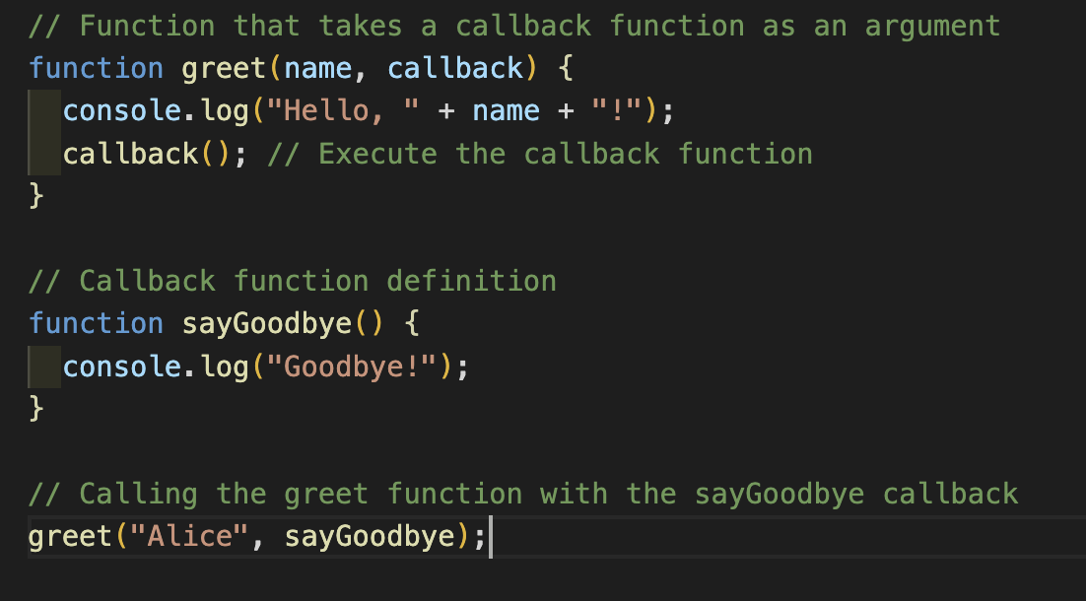
What is callback function?
In JavaScript, a callback function is a function that is passed as an argument to another function and is executed after the completion of a specific task or event. Callback functions are commonly used in asynchronous operations like handling AJAX requests, event handling, timers, and more. See the example below.
The greet function takes a name and a callback function as arguments. Inside the greet function, it logs a greeting message and then calls the callback function.
The sayGoodbye function is the callback function defined separately, which logs a farewell message.
When greet is called with the name 'Alice' and the sayGoodbye function as the callback, it logs "Hello, Alice!" first and then "Goodbye!".

